Slide 1


SIMATS ENGINEERING Saveetha Institute of Medical and Technical Sciences Chennai-602105 CSA0927 - PROGRAMMING IN JAVA
A Smart Event Management Framework for Real-Time Crowd Monitoring, Secure Entry, and Predictive Analytics
Guided by:
Dr. S. PUSHPA LATHA
Presented by:
G.YaswanthReddy(192425267)
K.LohithKumar(192511155)
J.YoganjuluReddy (192525352)
P.Kiran (192525201)

Slide 2
INTRODUCTION
Large-scale events often face challenges such as overcrowding, long entry queues, security risks, and inefficient event planning.
Traditional event management systems rely on manual processes, making them slow and error-prone.
Smart technologies like QR-based ticketing, AI-driven crowd monitoring, and predictive analytics improve event operations.
This framework integrates automation, real-time monitoring, and intelligent decision-making.
It enhances visitor experience, organizer efficiency, and overall event safety.

Slide 3
Problem Statement
Manual ticket verification causes long waiting times.
Lack of real-time crowd monitoring increases safety risks.
Difficult to predict attendance and resource requirements.
Inefficient communication between organizers and security teams.
Limited insights into event performance after completion.
Existing systems do not provide integrated planning, monitoring, and analytics.

Slide 4
Objectives
Develop a centralized smart event management platform.
Enable secure QR-code based ticket verification.
Monitor crowd density using AI and real-time analytics.
Predict attendance and optimize resource allocation.
Improve visitor safety through intelligent alerts.
Provide interactive dashboards for event organizers.
Enhance decision-making using predictive analytics.

Slide 5
Proposed System
Proposed System
The proposed system consists of four intelligent modules:
Event Planning and Scheduling
QR-Based Ticket Generation and Validation
AI-Based Crowd Monitoring
Predictive Analytics Dashboard
Features
Automated ticket management
Secure QR authentication
Real-time crowd monitoring
Capacity alerts
Attendance prediction
Interactive dashboards

Slide 6
Literature Review
S.No | Year | Author | Title | Journal | Methodology | Drawbacks
1 | 2025 | Darsena et al. | Sensing Technologies for Crowd Management | IEEE Review | IoT, Crowd Sensing | Limited to transportation systems
2 | 2024 | Zhou et al. | Understanding Crowd Behaviors in a Social Event | arXiv | WiFi Sensing, Data Mining | No ticketing or access control
3 | 2024 | Ameen et al. | Advancements in Crowd-Monitoring Systems | arXiv | AI, Computer Vision | High computational cost
4 | 2023 | collins | Event Management System with QR Code-Based Check-in | SJAIBT | QR Code, Cloud Computing | Limited predictive analytics
5 | 2025 | Roy Choudhury et al. | Drishti AI-Event Guardian | arXiv | YOLOv8, Deep Learning | Focuses mainly on crowd monitoring

Slide 7
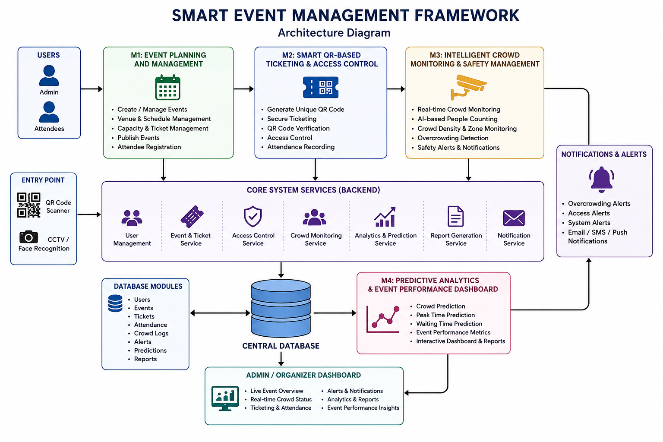
System Architecture

Slide 8
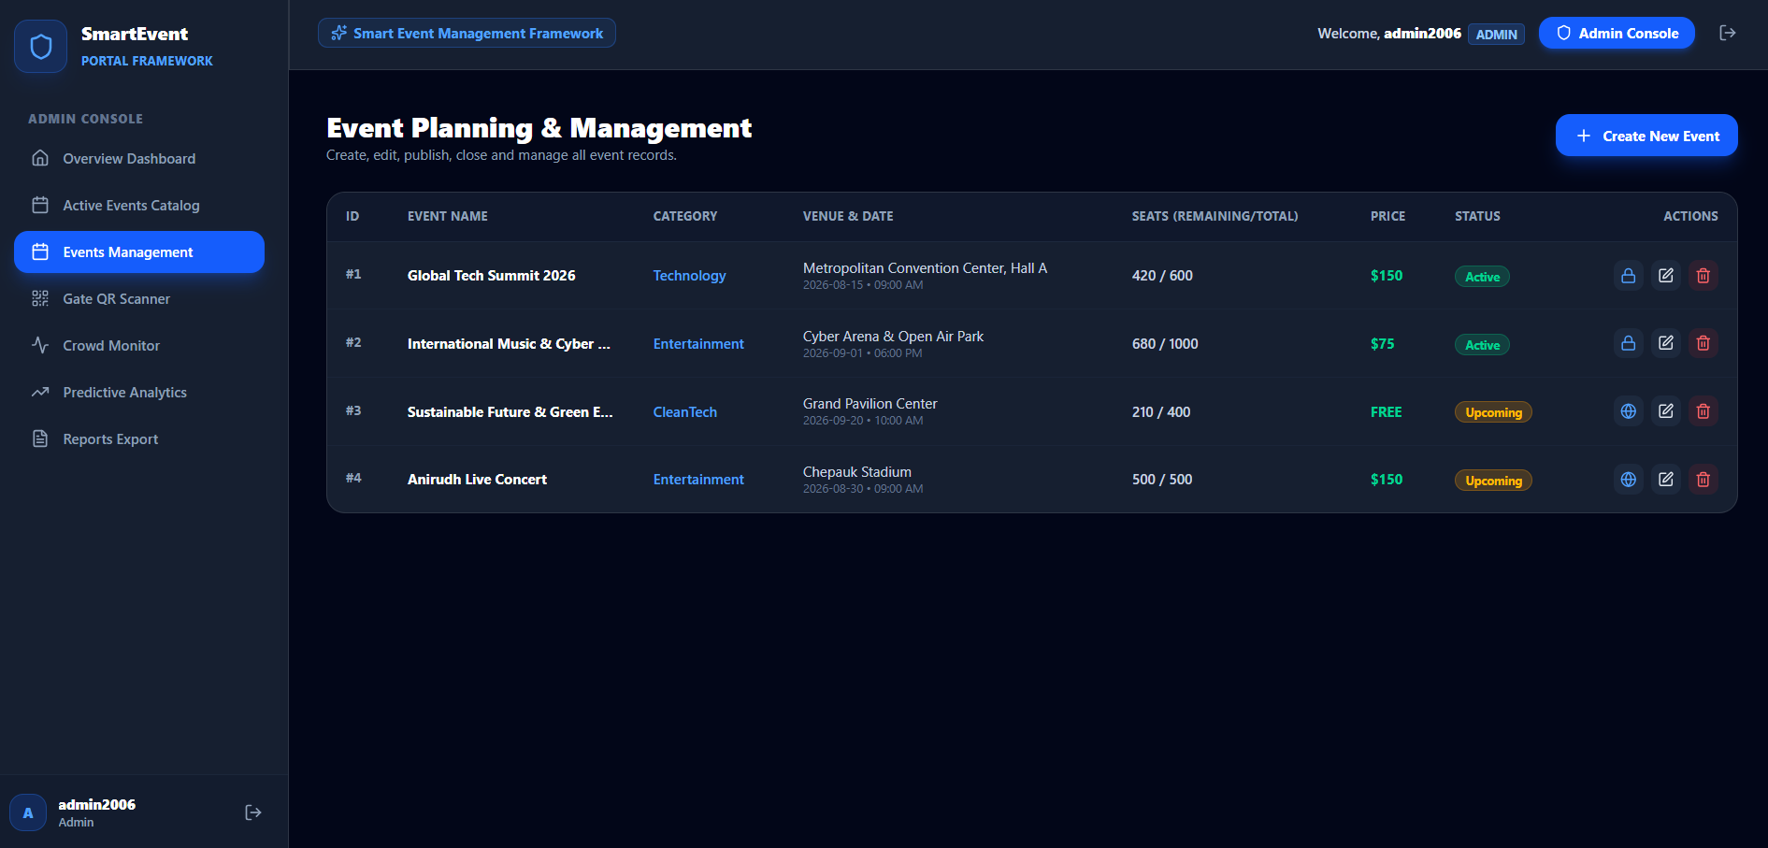
Module 1 – Event Planning and Management
Creates and schedules events with venue, date, and time details.
Manages event resources such as staff, equipment, and vendors.
Organizes event timelines and activity schedules.
Allocates budgets and tracks event-related expenses.
Sends notifications and updates to organizers and participants.
Maintains centralized event information for smooth coordination.

Slide 9
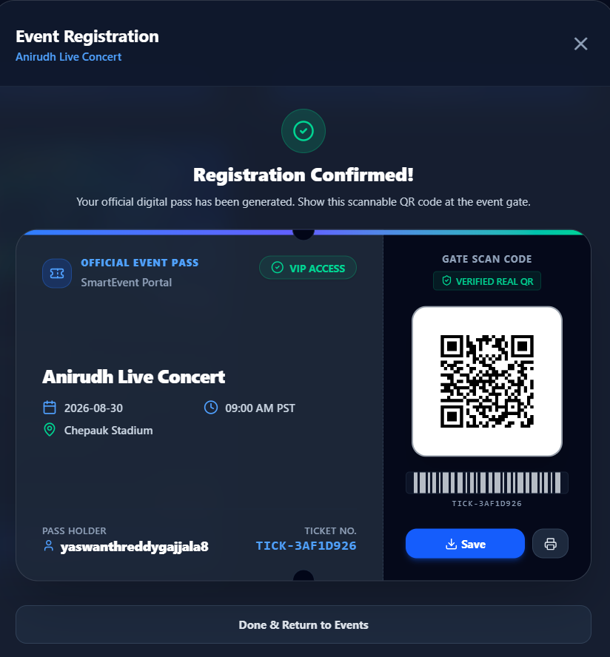
Module 2: Smart QR-Based Ticketing and Access Control
Generates unique and secure QR-code tickets for attendees.
Validates QR codes at entry points for fast authentication.
Prevents duplicate entries and detects fraudulent tickets.
Tracks real-time attendance and entry/exit records.
Reduces waiting time through automated access control.
Enhances security with digital verification and monitoring.

Slide 10
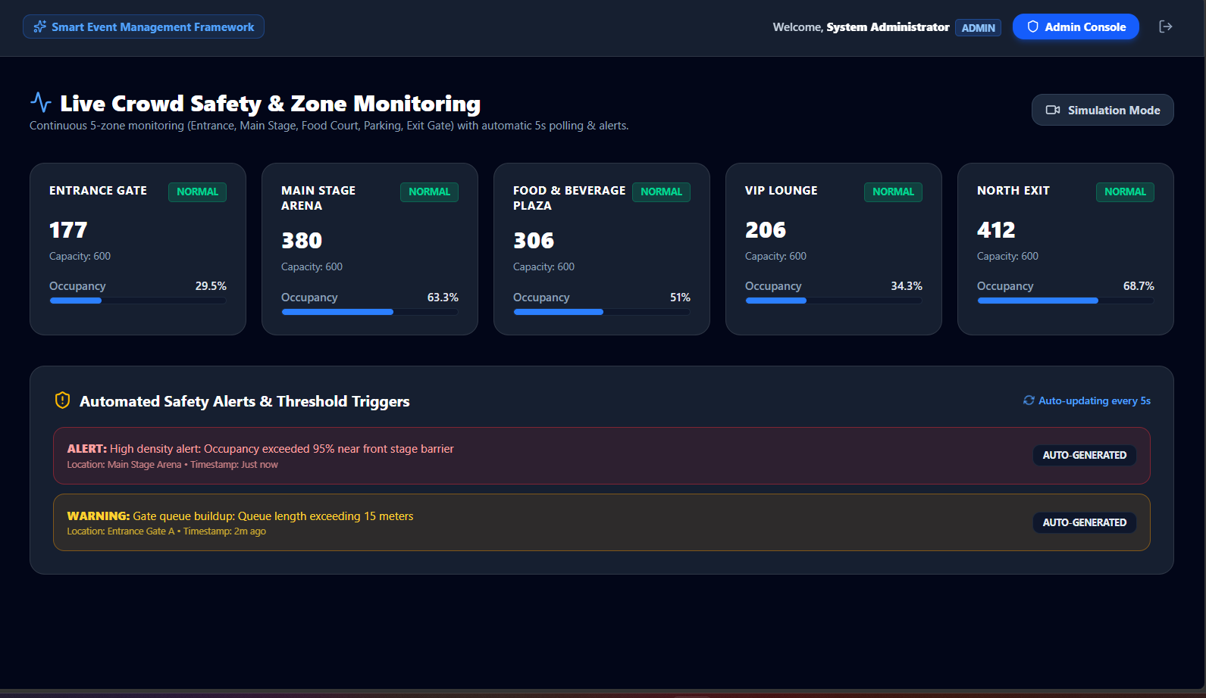
Module 3: Intelligent Crowd Monitoring and Safety Management
Monitors crowd density using AI-enabled cameras and sensors.
Detects overcrowding and unusual crowd movements in real time.
Generates instant safety alerts during emergency situations.
Assists security personnel with live crowd status updates.
Visualizes crowd distribution through heatmaps and dashboards.
Improves visitor safety by preventing congestion and accidents.

Slide 11
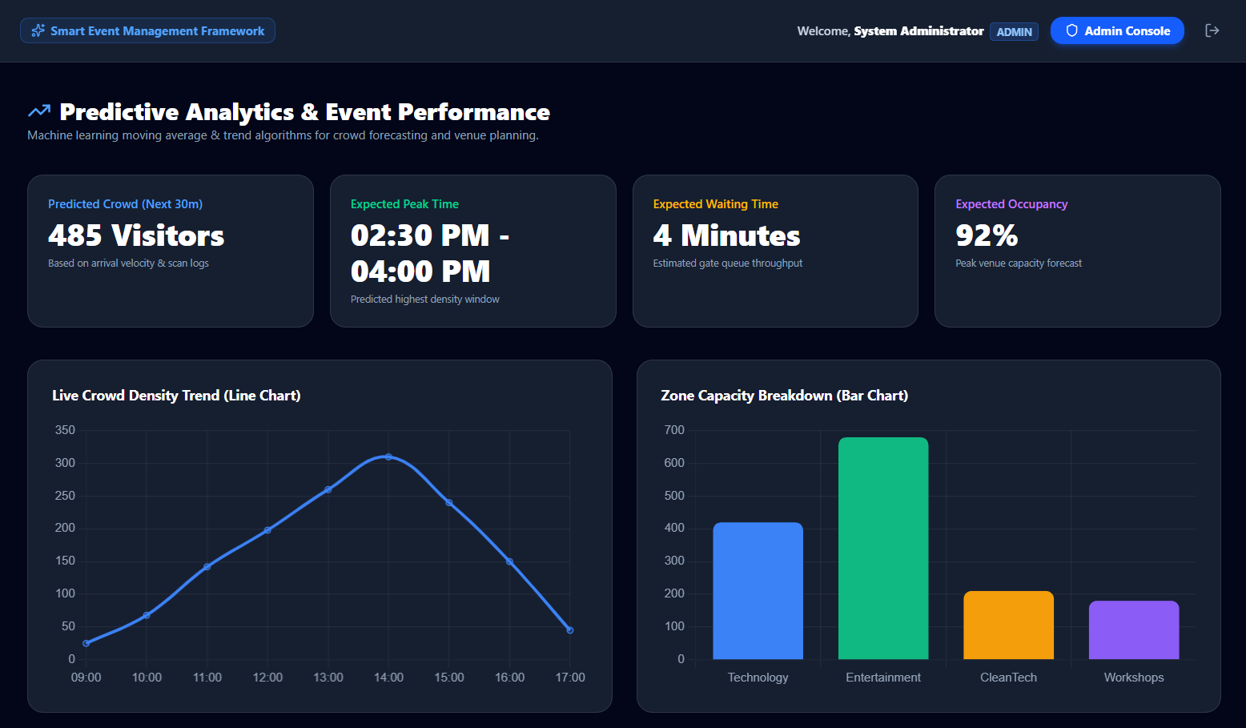
Module 4: Predictive Analytics and Event Performance Dashboard
Analyzes historical and real-time event data.
Predicts attendance, resource requirements, and revenue trends.
Provides interactive dashboards with key performance indicators (KPIs).
Evaluates visitor engagement and event success metrics.
Supports data-driven decision-making for future events.
Generates detailed reports to improve event planning and management.

Slide 12
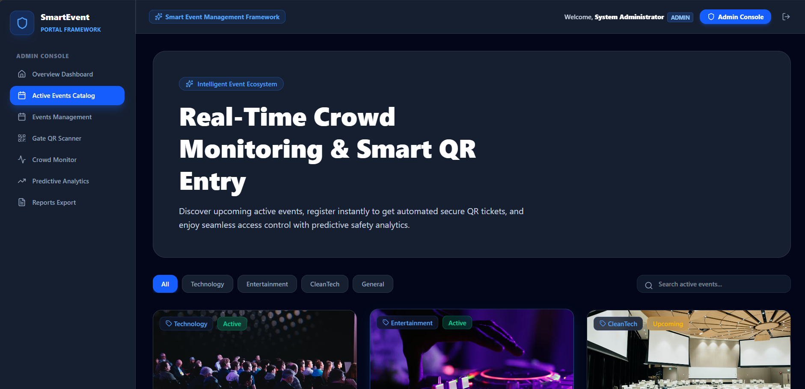
Final output

Slide 13
Challenges & Limitations
Challenges
Large-scale real-time data processing
Camera placement limitations
Network connectivity issues
Data synchronization
Privacy concerns
Limitations
Requires internet connectivity
Camera quality affects crowd monitoring accuracy
AI prediction depends on historical data quality
High initial deployment cost

Slide 14
Future Scope
Facial recognition entry system
IoT sensor integration
Drone-based crowd surveillance
Smart parking management
AI chatbot support
Multi-event management platform
Digital payment integration
Cloud-based scalable deployment

Slide 15
Conclusion
The proposed framework integrates planning, ticketing, crowd monitoring, and analytics into a single smart platform.
AI and QR technologies improve operational efficiency and visitor safety.
Predictive analytics supports better planning and decision-making.
The system reduces manual effort and enhances the overall event experience.
It provides a scalable solution suitable for concerts, exhibitions, conferences, and public gatherings.

Slide 16
References
X. Zhang, AI-Based Crowd Monitoring for Smart Events, IEEE Access, 2024.
S. Kumar et al., Secure QR Code Ticketing System, Springer, 2023.
M. Patel, Predictive Analytics in Event Management, Elsevier, 2024.
A. Singh et al., Smart Event Management Using IoT and AI, IEEE, 2023.
K. Lee, Real-Time Crowd Density Estimation Using Computer Vision, ACM Digital Library, 2022.
R. Sharma, Machine Learning Applications in Smart City Event Management, Springer Nature, 2024.

Slide 17
THANK YOU

